Slide 1
Luca Cossu & Michele Atzeni
Research applications

Slide 2
Outline
IMPACT
DEEP
AIRPREDICT
TimeRun

Slide 3
Clinical Trials
Essential instrument to test newly developed solutions for disease management and care
Multiple patients in parallel
Data gathering for assessment of the examined methodology

Slide 4
Data Gathering
Different sources (automatic sensors, manual input,…) and format (numeric, raw text description,…)
Lack of standardization of data schema
Need of normalization before data availability for research purposes

Slide 5
Our solution
During my master thesis I have developed and briefly tested a mobile platform built in Flutter
The platform allows for conduction of simple clinical trials
It integrates automatic data collection from different sources

Slide 6
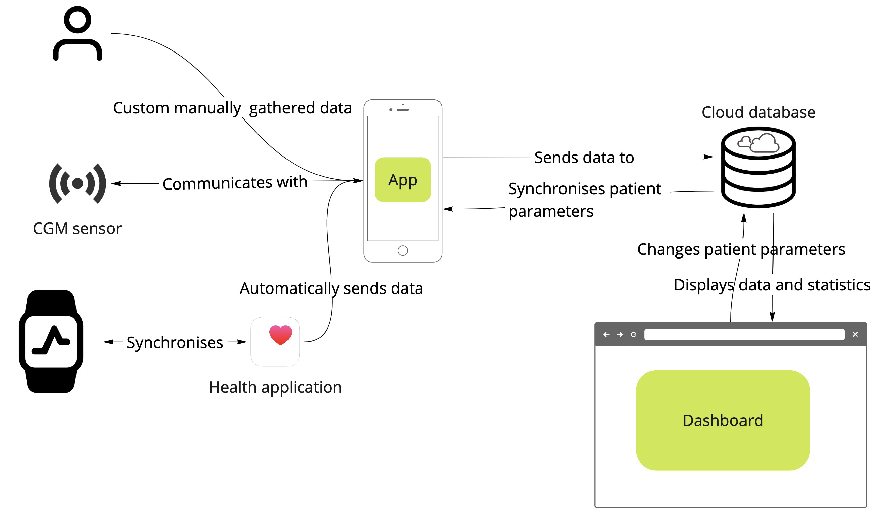
Platform structure
Cloud database
Mobile application with wearable devices integration
Monitoring interface for real-time monitoring

Slide 7
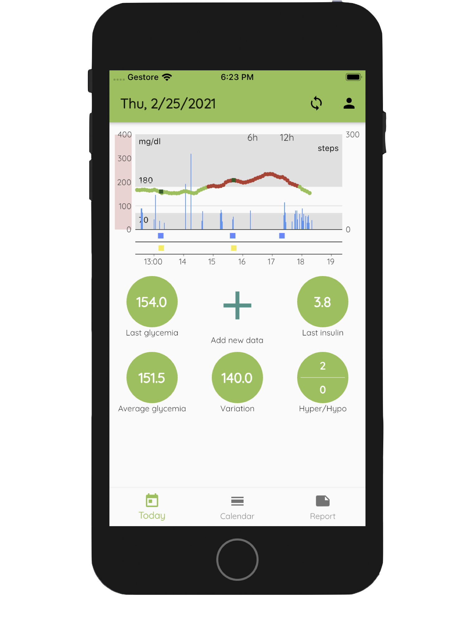
Mobile application
iOS application
Dexcom© G6 sensor integration
HealthKit integration
Manual data logging
Statistics over different time periods
PDF report creation and sharing capabilities

Slide 8
Outline
IMPACT
DEEP
AIRPREDICT
TimeRun

Slide 9
Context of the DEEP platform
Adaptation of the IMPACT platform to the study
Post bariatric surgery patients with post-prandial hypoglycaemic events
Objectives:
Understand and predict blood glucose dynamic in this population
Predict hypoglycaemic events
Therapy effects on glucose fluctuations

Slide 10
Multiple data types to be gathered
Blood glucose
Meal intakes (kind and quantity)
Hypoglycemia symptoms
Physical activities (steps automatically collected)
Drug intakes with comments and informations
Sleep cycles

Slide 11

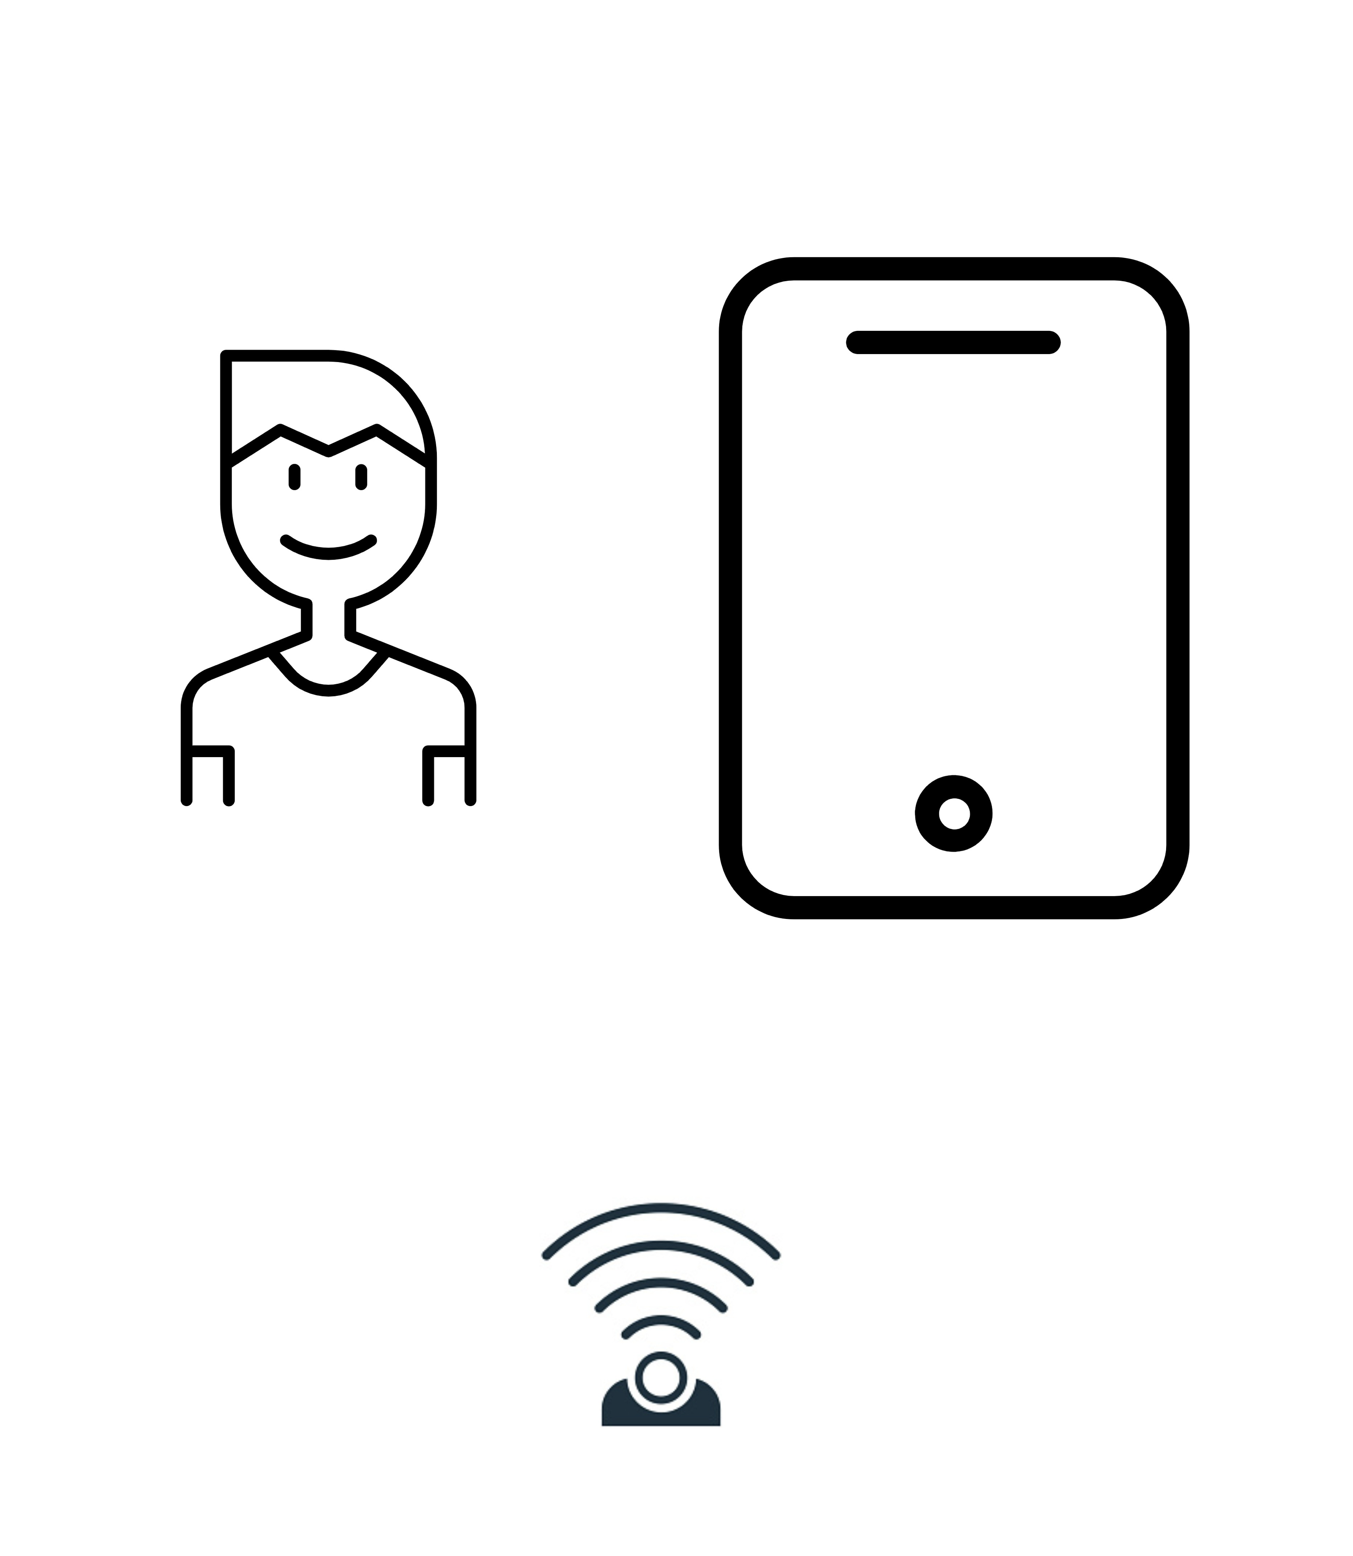

Real time capabilities
Data collection from multiple devices
Continuous Glucose Monitoring sensor (CGM)
Fitness trackers (Apple health integration)
Patient monitoring via web interface
Simple real-time algorithms to be tested
Change trial settings
Blinding of CGM data

Slide 12
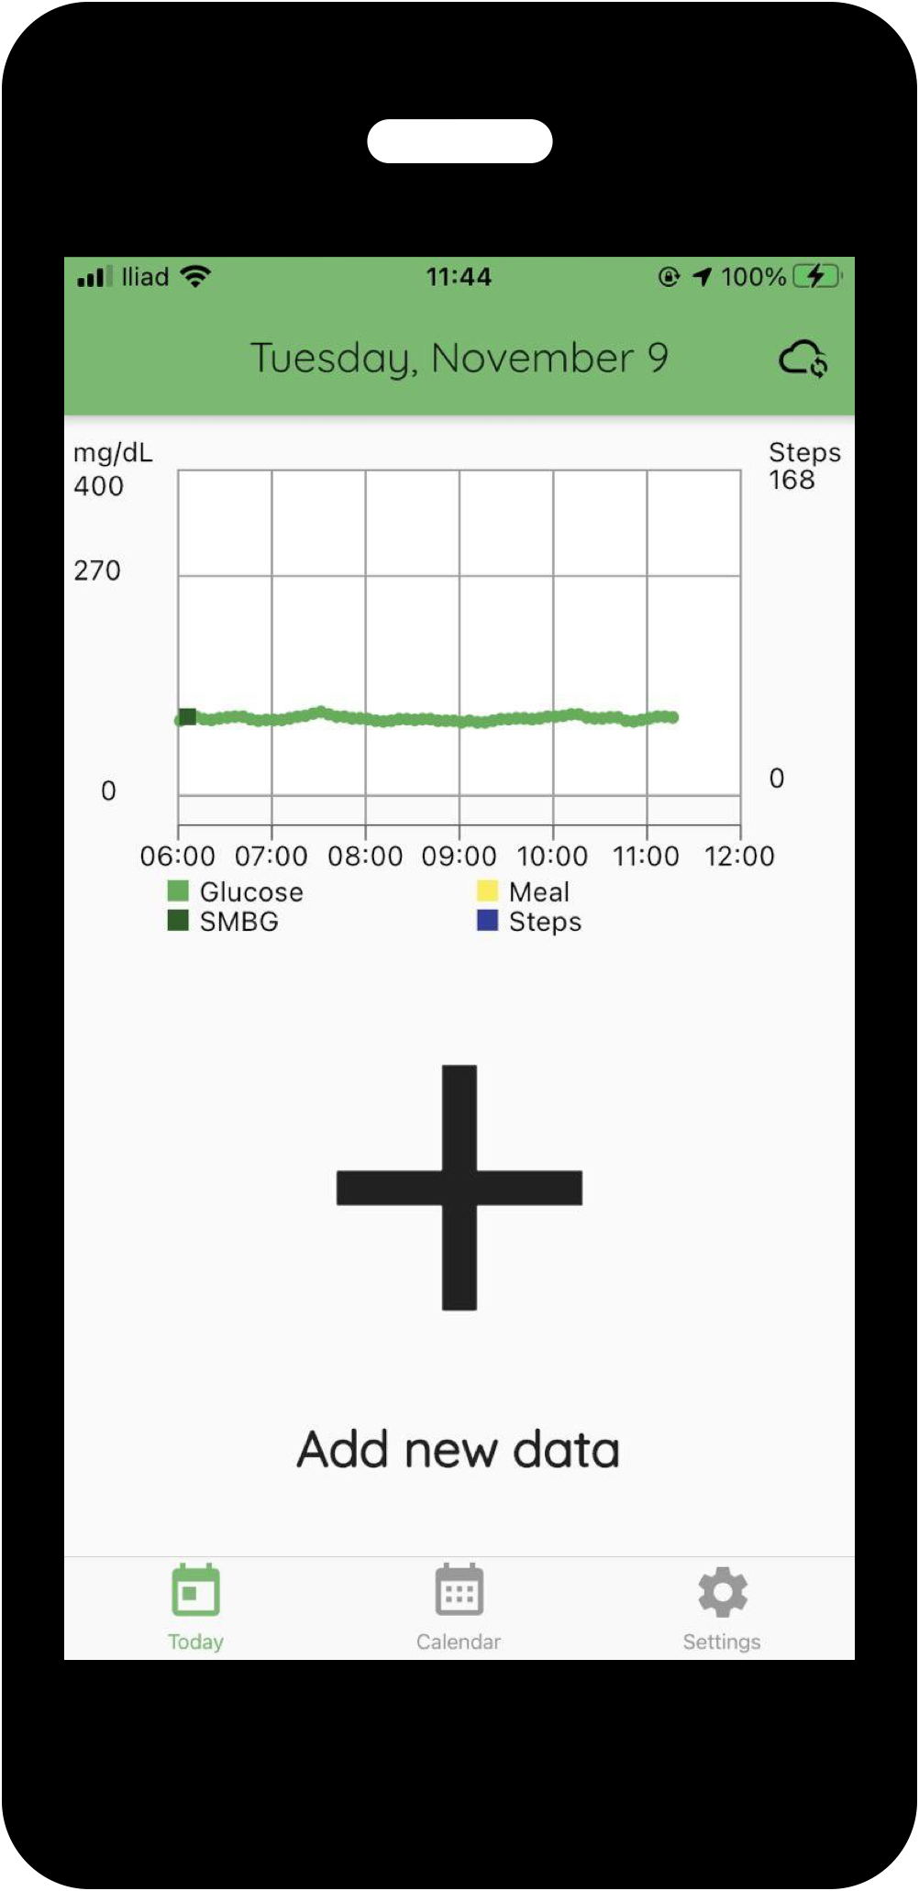
Mobile application
Real time communication with multiple wearable sensors
Completely customisable in theme and features
Able to run simple real time algorithms
Active custom notifications for specific events

Slide 13
Web interface
Overview of all enrolled patients
Per patient details and statistics
Daily analysis page
Custom features
Custom trial settings

Slide 14
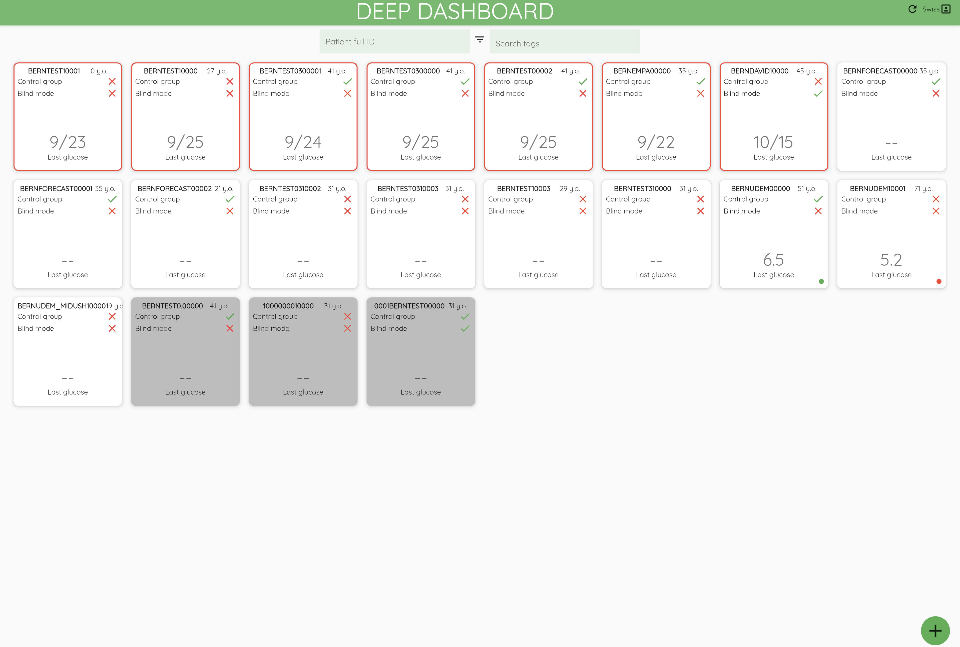
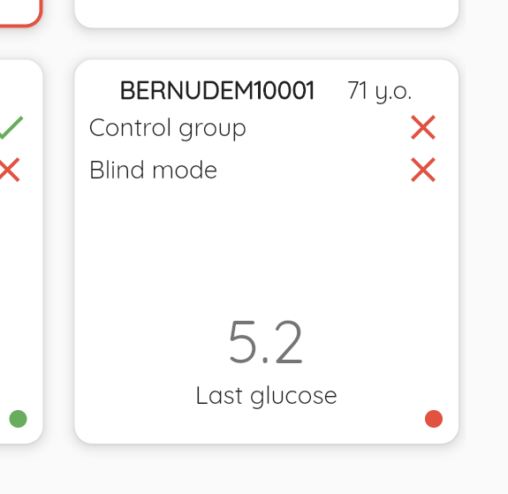
Patients overview
Landing page for the clinician website.
Alerts and status of patients at a glance
Enrolment of new patient

Slide 15
Live demo

Slide 16
Outline
IMPACT
DEEP
AIRPREDICT
TimeRun

Slide 17
Air Pollution
Air pollution is a global issue that has a significant impact on human health
The quality of air is an environmental factor that affects non-transmissible illnesses such as respiratory and neurodegenerative diseases.

Slide 18
Asthma
Asthma is a disease characterised by diffuse inflammation of the airways
Relapses, i.e. exacerbations, are defined as an acute and severe loss of disease control requiring urgent treatment.

Slide 19
The Problem
Problem
Exposure to air pollution is a crucial risk factor for asthma exacerbation
Hence, air pollution can significantly impact the quality of life of asthma patients
Preventing exacerbation episodes is critical in improving the prognosis of asthma
Current state-of-the-art predictive models for asthma exacerbation mostly do not consider risk factors related to pollution
A dynamic personal exposure assessment can enable real-time personalized predictions of exposure-induced adverse events

Slide 20
The Planned Approach
Develop a new smart monitoring system, consisting of
Wearable and portable Internet-of-Things sensors
Mobile and a web applications
Cloud database (IMPACT)
Data analysis and Machine Learning
The monitoring system will be tested in a population of asthma patients followed at the Respiratory Disease Clinic of University of Padova (DCTV).

Slide 21
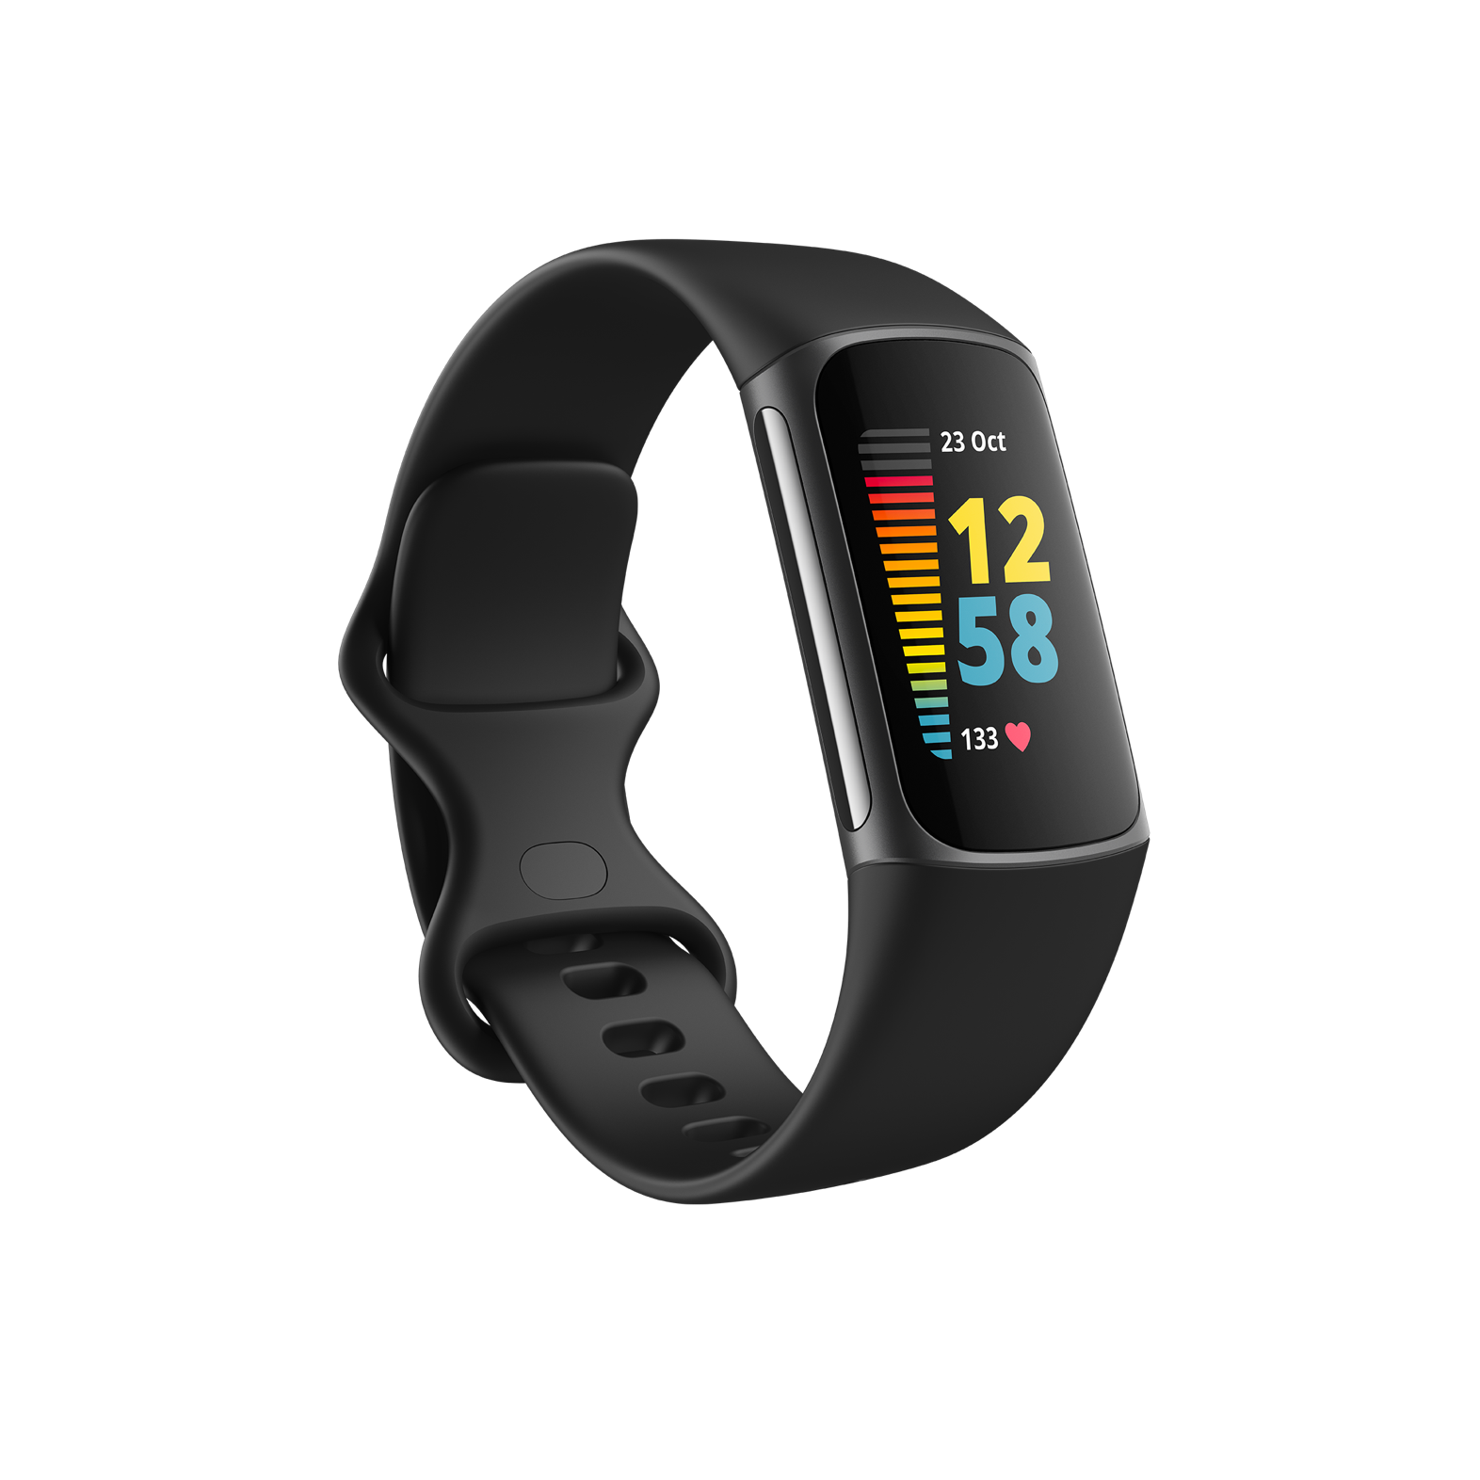
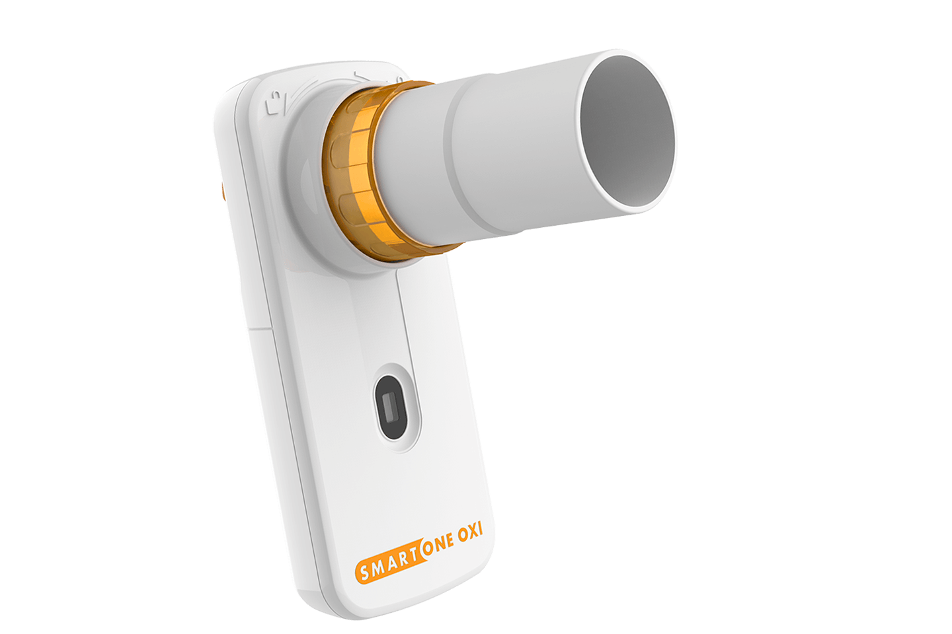
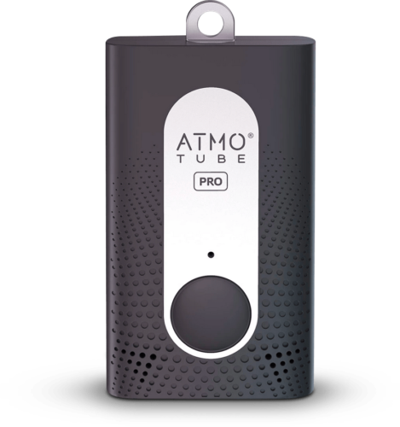
IoT Sensors
Atmotube PRO
Portable air quality monitoring device
Measures
pollutant concentrations,
weather indices, total volatile organic compounds,
temperature, humidity, and pressure
Fitbit Charge 5
Smartwatch that captures
heart rate
physical activity information.
Stress
SpO2
MIR Smart One
Pocket-sized, personal spirometer
Measures
Peak flow rate (PEF)
Forced expiratory volume (FEV1)

Slide 22

Mobile Application
Personal Exposure Tool Leveraging Bluetooth Low Energy (BLE) communication and Web APIs, wearable/portable sensor data is gathered to compute the Personal Exposure (i.e Inhalation).
Asthma Diary User can report an Asthma Attack, the Spirometry test done daily and also the Asthma Control Test (ACT). Logs can be visualized in the asthma diary page.

Slide 23

Clinical Web Dashboard
Patients enrolment for the trial Create a new patient within the IMPACT platform, hence enrol a new asthmatic patient into the Airpredict trial.
Monitor Patients’ Asthma Control Possibility to check the exposure and asthma related trends for each patient that had sync their data with the IMPACT Cloud Database.

Slide 24

Data Analysis and Machine Learning
Collected patient-generated and environmental data will be used
Find the factors influencing asthma exacerbations Identification of the air pollution exposure factors that most increase the risk of asthma exacerbations.
Artificial Intelligence predictive modeling The development of AI predictive models to predict the risk of future exacerbations in asthma patients, considering clinical and environmental factors.

Slide 25
Live demo

Slide 26
Outline
IMPACT
DEEP
AIRPREDICT
TimeRun

Slide 27
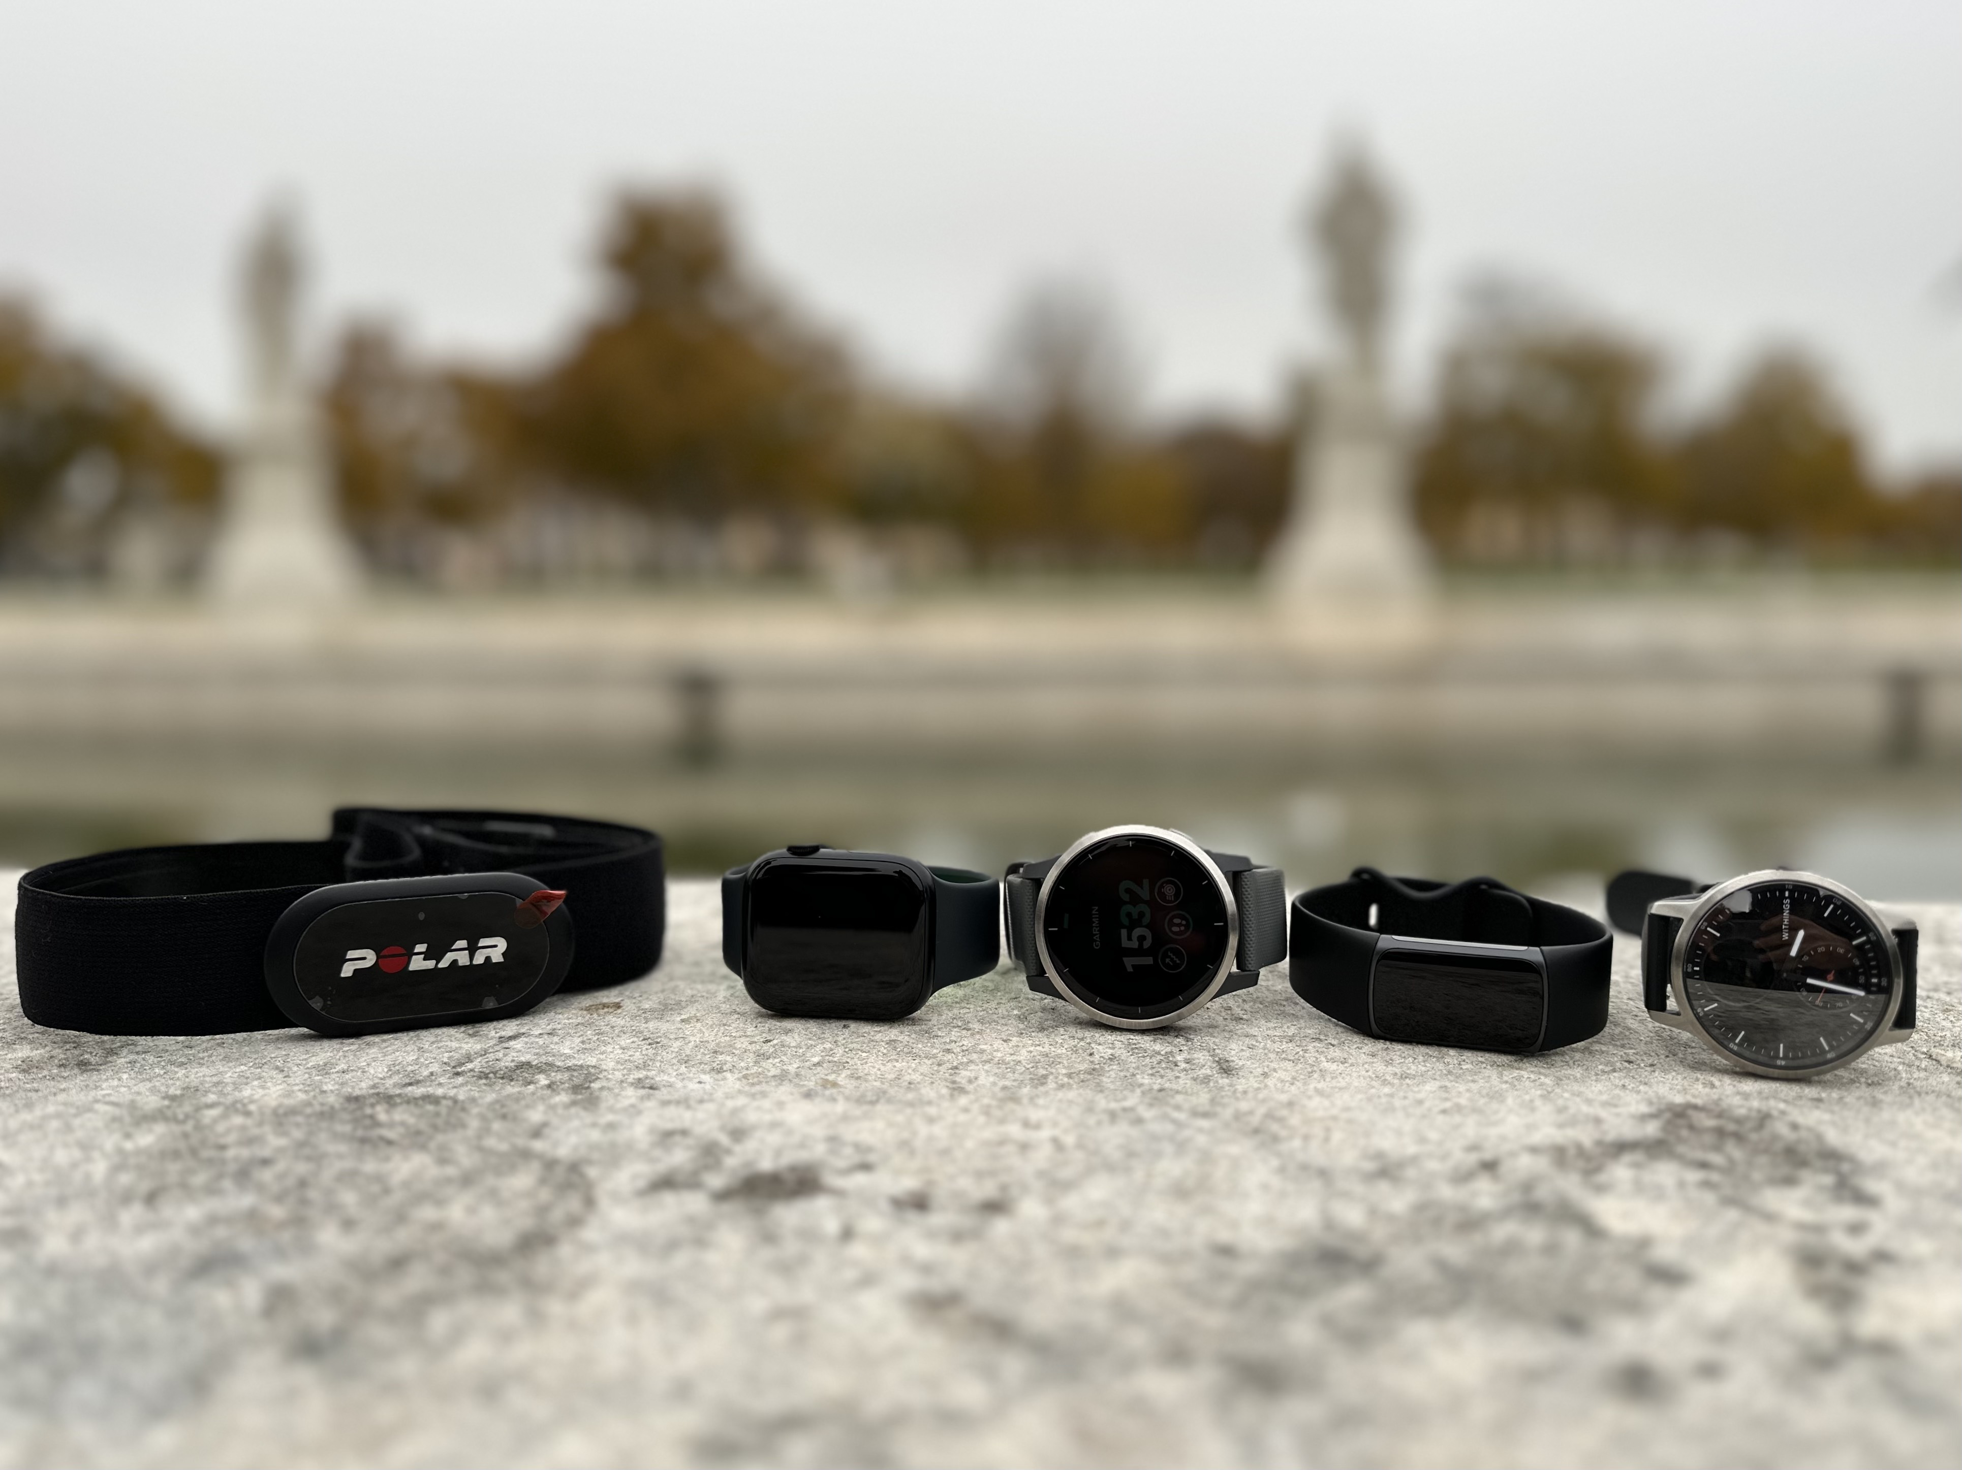
Setting
Master thesis project of last year’s BWTHW student
Accuracy comparison between multiple smartwatches to be used in future studies
Apple Watch 8
Garmin Vivoactive 4
Fitbit Charge 5
Withings Scanwatch

Slide 28
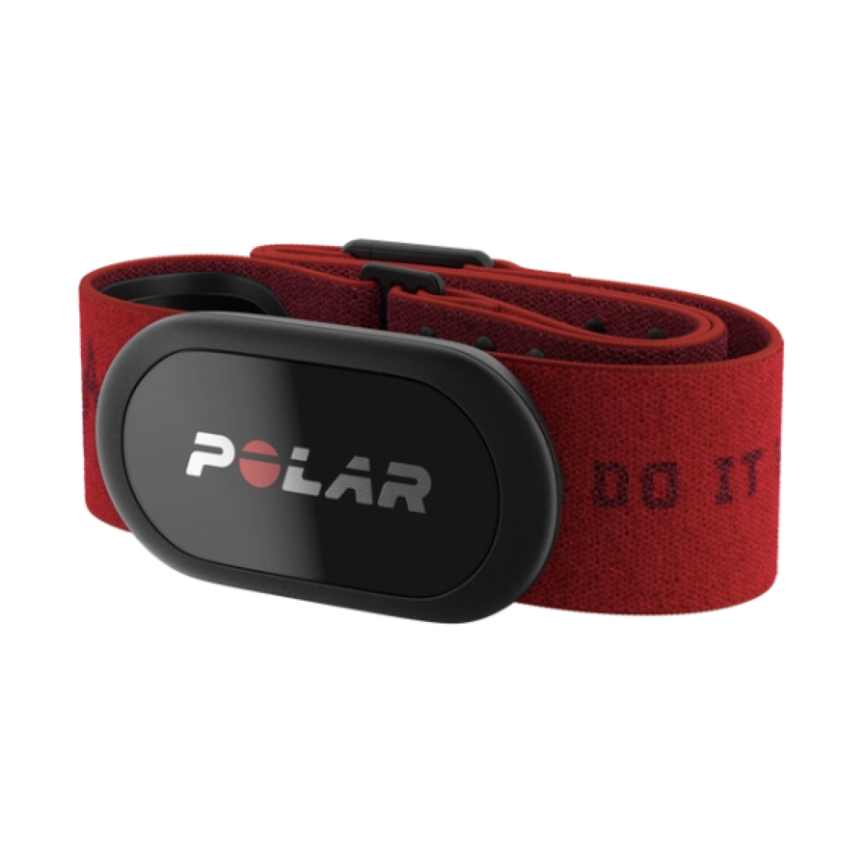
Gold standard
Polar H10
ECG sensor considered one of the most accurate¹ on the market
Simple bluetooth integration
¹ https://www.polar.com/sites/default/files/static/science/white-papers/polar-h10-heart-rate-sensor-white-paper.pdf

Slide 29
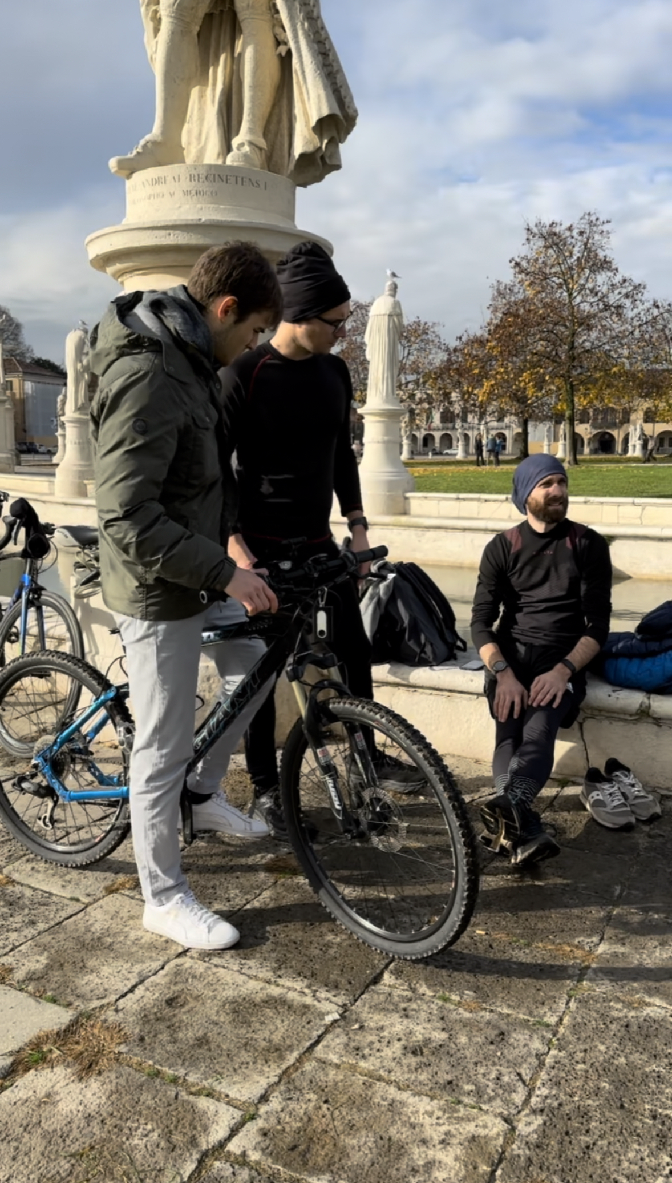
Protocol of the study
10 participants
Running activity to span over all heart rate zones
Two minutes of run for each heart rate zone
Running speed is guided by the master thesis student giving instructions to the participant to keep the heart rate in the required zone
Use of a mobile app built by the student to monitor the participant in real time

Slide 30
Practical demonstration

